Slide 1
DRIVER VIGILANCE SYSYTEM
SHAHARBAN MP
ROLL NO:MES20MCA-2047
FEBIN AZIZ

Slide 2
TABLE OF CONTENTS
CONTENT | PAGE
Description About Project
Modules
Data Flow Diagram
Table Design
Developing Environment
User Story
Product Backlog
Project Plan
Sprint plans
Sprint 1 Actual

Slide 3
INTRODUCTION
In recent years, the increasing number of vehicles on roads leads to an increase in traffic accidents. It is found that distracted driving was related to one-tenth of fatal crashes. Distracted driving fatalities have increased more rapidly than those caused by drunk driving, speeding and failing to wear a seat belt. A driver is considered to be distracted when there is an activity that attracts his/her attention away from the task of driving. Distracted driving is an established cause of motor vehicle crashes for all ages. With the rapidly growing elderly population and more adults embracing technology, distracted driving is also increasing in prevalence within that population—particularly cell phone usage behind the wheel. Another cause of accidents is drowsiness during driving.
The main objective of the proposed system is to detect drowsiness in drivers and alert them on time to avoid occurrence of accidents. In addition, activities such as usage of phone, turning around, picking something from rear seat during driving can lead to accidents. Detection of such activities on time can help in reducing accidents to an extent. To overcome this issue, we propose a distraction detection system that has the potential to be implemented in real vehicles. The proposed work focuses on driver distraction activities detection via images using different kinds of machine learning techniques. The input of our model is videos of driver taken in the car.

Slide 4
MODULES
MODULE 1:- DRIVER APP
Registration
Login
Partner Setting
Auto messaging to own contacts
Location Sharing
Driving pattern detection using mobile sensors
Camera assistance while closing eyelids(sleeping)
Voice assistance support
Get road condition notification using GPS
MODULE 2:- PARTNER APP
Login
View drivers(partners)
Driver phone mode settings

Slide 5
a. Speed based
b. Vehicle angle based
main settings are,
1.Call blocking
2.Screen light intensity setting
3.Screen lock while speed increases
4.Auto smising service
5.Ring mode settings
View Locations

Slide 6
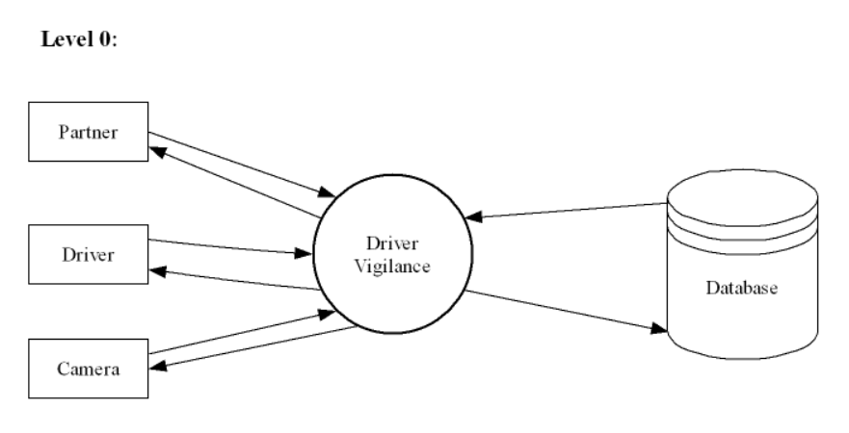
DATA FLOW DIAGRAM

Slide 7
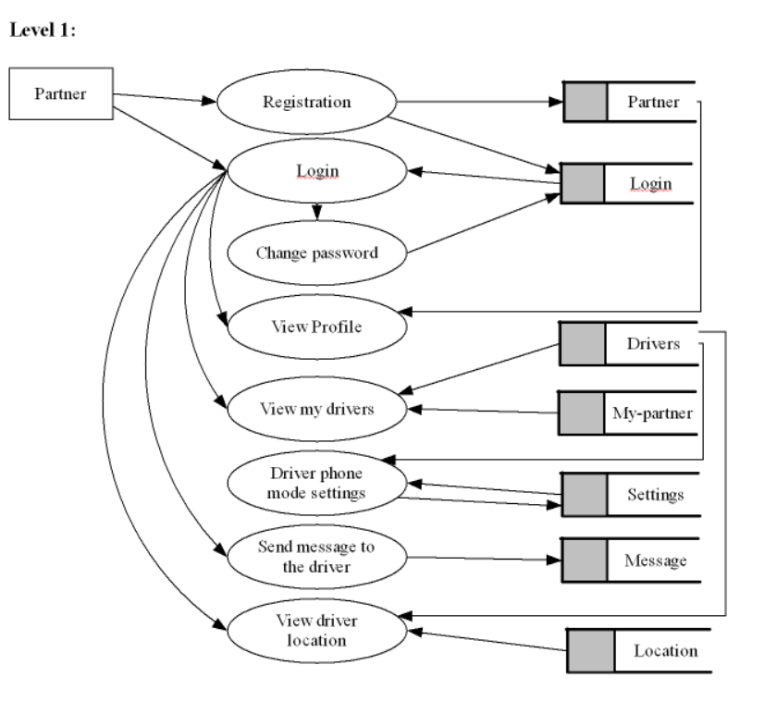

Slide 8
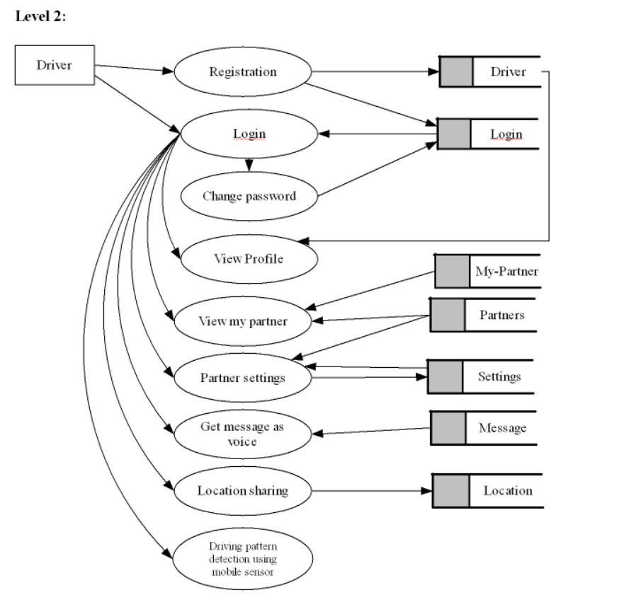

Slide 9
TABLE DESIGN
1. Login:
Field Name | Datatype | Constraints
Lid | Int | Primary Key
Username | Varchar (50) | Not Null
Password | Varchar (50) | Not Null

Slide 10
2. Driver:
Field Name | Datatype | Constraints
Driver id | Int | Primary Key
D name | Varchar (50) | Not Null
Place | Varchar (50) | Not Null
post | Varchar (50) | Not Null
pin | Varchar(50) | Not Null
District | Varchar(50) | Not Null
Email | Varchar(50) | Not Null
Phone | Varchar(50) | Not Null
Image | Varchar(50) | Not Null

Slide 11
3. Partner:
Field Name | Datatype | Constraints
pid | Int | Primary Key
P name | Varchar(50) | Not Null
Image | Varchar(50) | Not Null
Place | Varchar (50) | Not Null
post | Varchar (50) | Not Null
Pin | Bigint | Not Null
District | Varchar(50) | Not Null
Email | Varchar(50) | Not Null
Phone | Bigint | Not Null

Slide 12
4. Location:
Field Name | Datatype | Constraints
Location id | Int | Primary Key
Driver id | Int | Not Null
Lattitude | Varchar (50) | Not Null
Longtitude | Varchar (50) | Not Null
Date | Date | Not Null
time | time | Not Null
5.Message:
Field Name | Datatype | Constraints
Message id | int | Primary key
Partner id | int | Not Null
Driver id | int | Not Null
Message date | date | Not Null

Slide 13
DEVELOPING ENVIRONMENT
Hardware Requirements
Input Device : Mouse, Keyboard
Output Device : Monitor
Memory : 4 Gb Ram (Minimum)
Processor : Intel core i3 or above
Software Requirements
Operating System : Windows 8 /10for Better Performance
Front End : Android
Back End : MySQL , Python (Flask)
Software Used : PyCharm , Android Studio ,SQLyog
Web Browser : Internet Explorer/Google Chrome/Firefox(for web application)

Slide 14
PRODUCT BACKLOG
User story ID | Priority <High/Medium/Low> | Size (Hours) | Sprint <#> | Status <Planned/In progress/Completed> | Release Date | Release Goal
1 | Medium | 5 | 1 | Completed | 10/01/2022 | Form designing and table designing
2 | High | 5 |  | Completed | 10/01/2022 | Coding
3 | Medium | 5 | 2 | Planned |  | Form designing
4 | High | 5 |  | Planned |  | Coding
5 | Medium | 6 | 3 | planned |  | Form designing
6 | High | 8 |  | Planned |  | Coding
7 | Medium | 8 | 4 | Planned |  | Embedded, Configuration
8 | High | 8 |  | Planned |  | Configuration testing, Implementation

Slide 15
USER STORY
User Story ID | As a type of User | I want to < perform some task > | So that I can < Achieve Some Goal >
1 | Driver | Sign Up | Driver details can be added to the system
2 | Driver | Login | I can get access to the system
3 | Driver | Change password | I can change my login credential
4 | Driver | Add partner | I Can add my partner for the ride
5 | Driver | View partner | I can view the partner details added to the system
6 | Driver | Edit partner | Can edit the partner details
7 | Driver | Delete partner | Can remove partner
8 | Driver | Location Sharing | Can share the location
9 | Camera | Camera surveillance | Can detect driving pattern

Slide 16
10 | Partner | Sign UP | Partner details can be added to the system
11 | Partner | Login | I can get access to the system
12 | Partner | Change password | I can change my login credential
13 | Partner | View my driver | Can view the driver details
14 | Partner | View driver location | Can view driver location
15 | Partner | Send message | Can send massage to the driver
16 | Partner | Driver phone mode settings | Can change driver phone mode based on speed and vehicle angle based

Slide 17
PROJECT PLAN
User Story ID | Task Name | Start Date | End Date | Days | Status
1 | Sprint 1 | 07-12-2021 | 25-12-2021 | 4 | completed
2 |  | 26-12-2021 | 11-01-2022 |  | completed
3 | Sprint 2 | 29-12-2021 | 29-12-2021 | 4 | Planned
4 |  | 15-01-2022 | 15-01-2022 |  | Planned
5 | Sprint 3 | 22-01-2022 | 22-01-2022 | 8 | planned
6 |  | 23-01-2022 | 23-01-2022 |  | planned
7 | Sprint 4 | 05-02-2022 | 06-02-2022 | 4 | planned
8 |  | 12-02-2022 | 12-02-2022 |  | planned

Slide 18
SPRINT BACKLOG PLAN
Backlog Item | Status and Completion date | Original Estimate in hours | Day 1 25/12 | Day 2 26/12 | Day 3 27/12 | Day 4 28/12 | Day 5 29/12 | Day 6 30/21 | Day 7 31/12 | Day 8 01/01 | Day 9 02/01 | Day 10 03/01 | Day 11 04/01 | Day 12 05/01 | Day 13 06/01 | Day 14 07/01
User story #1,2,3 |  |  | Hrs | Hrs | Hrs | Hrs | Hrs | Hrs | Hrs | Hrs | Hrs | Hrs | Hrs | Hrs | Hrs | Hrs
UI designing | 25/12/2021 | 5 | 1 | 0 | 2 | 2 | 0 | 0 | 0 | 0 | 0 | 0 | 0 | 0 | 0 | 0
Coding | 01/01/2022 | 8 | 0 | 0 | 0 | 0 | 2 | 1 | 0 | 2 | 0 | 1 | 2 | 0 | 0 | 0
Testing | 03/01/2022 | 2 | 0 | 0 | 0 | 0 | 0 | 0 | 0 | 0 | 0 | 0 | 0 | 1 | 1 | 0
User story #4,5,6,7,8,9
UI Designing | 15/01/2022 | 3 | 3 | 0 | 0 | 0 | 0 | 0 | 0 | 0 | 0 | 0 | 0 | 0 | 0 | 0
Coding | 16/01/2022 | 3 | 0 | 1 | 0 | 0 | 0 | 2 | 0 | 0 | 0 | 0 | 0 | 0 | 0 | 0
Testing | 20/01/2022 | 4 | 0 | 0 | 0 | 2 | 0 | 1 | 0 | 0 | 0 | 0 | 1 | 0 | 0 | 0
User story #10,11,12,13,14,15

Slide 19
UI Designing | 1/2/2022 | 5 | 0 | 0 | 2 | 0 | 0 | 0 | 0 | 2 | 0 | 0 | 1 | 0 | 0 | 0 | 0
Coding | 6/2/2022 | 8 | 0 | 1 | 2 | 0 | 1 | 0 | 2 | 0 | 1 | 0 | 0 | 1 | 0 | 0 | 0
Testing | 7/2/2022 | 2 | 0 | 0 | 0 | 1 | 1 | 0 | 0 | 0 | 0 | 0 | 0 | 0 | 0 | 0 | 0
User story#16
UI Designing | 12/2/2022 | 3 | 0 | 3 | 0 | 0 | 0 | 0 | 0 | 0 | 0 | 0 | 0 | 0 | 0 | 0 | 0
Coding | 16/2/2022 | 7 | 0 | 2 | 0 | 0 | 3 | 0 | 0 | 0 | 2 | 0 | 0 | 0 | 0 | 0 | 0
Testing | 20/2/2022 | 5 | 0 | 1 | 0 | 1 | 0 | 0 | 1 | 0 | 2 | 0 | 0 | 0 | 0 | 0 | 0

Slide 20
SPRINT BACKLOG ACTUAL
Backlog Item | Status and Completion date | Original Estimate in hours | Day 1 25/12 | Day 2 26/12 | Day 3 27/12 | Day4 28/12 | Day5 29/12 | Day6 30/12 | Day7 31/12 | Day8 01/01 | Day9 02/01 | Day 10 3/01 | Day 11 04/11 | Day 12 5/01 | Day 13 6/01 | Day 14 7/01 | Completed<Y/N>
User story #1,23 |  |  | Hrs | Hrs | Hrs | Hrs | Hrs | Hrs | Hrs | Hrs | Hrs | Hrs | Hrs | Hrs | Hrs | Hrs | Yes
UI designing | 25/12/2021 | 5 | 1 | 0 | 2 | 2 | 0 | 0 | 0 | 0 | 0 | 0 | 0 | 0 | 0 | 0 | Yes
Coding | 01/01/2022 | 8 | 0 | 0 | 0 | 0 | 2 | 1 | 0 | 2 | 0 | 1 | 2 | 0 | 0 | 0 | Yes
Testing | 03/01/2022 | 2 | 0 | 0 | 0 | 0 | 0 | 0 | 0 | 0 | 0 | 0 | 0 | 1 | 1 | 0 | Yes
Total |  | 15 | 1 | 0 | 2 | 2 | 2 | 1 | 0 | 2 | 0 | 1 | 2 | 1 | 1 | 0

